Slide 1
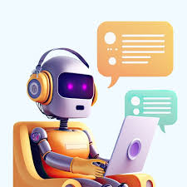

SupportGenie:AI-Powered Multi-Turn Customer Assisstance
Presented By:
Varshitha Y
Sanghavi Y
Manogna R

Slide 2
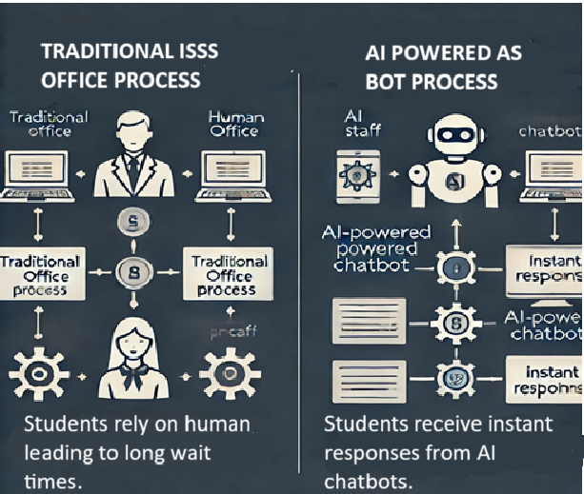
Introduction:
This project aims to create an AI-powered chatbot for UMBC's ISSS office to improve efficiency and student accessibility.
Currently, ISSS relies on human staff, which can be slow. Our chatbot will handle common inquiries and requests autonomously.

Slide 3

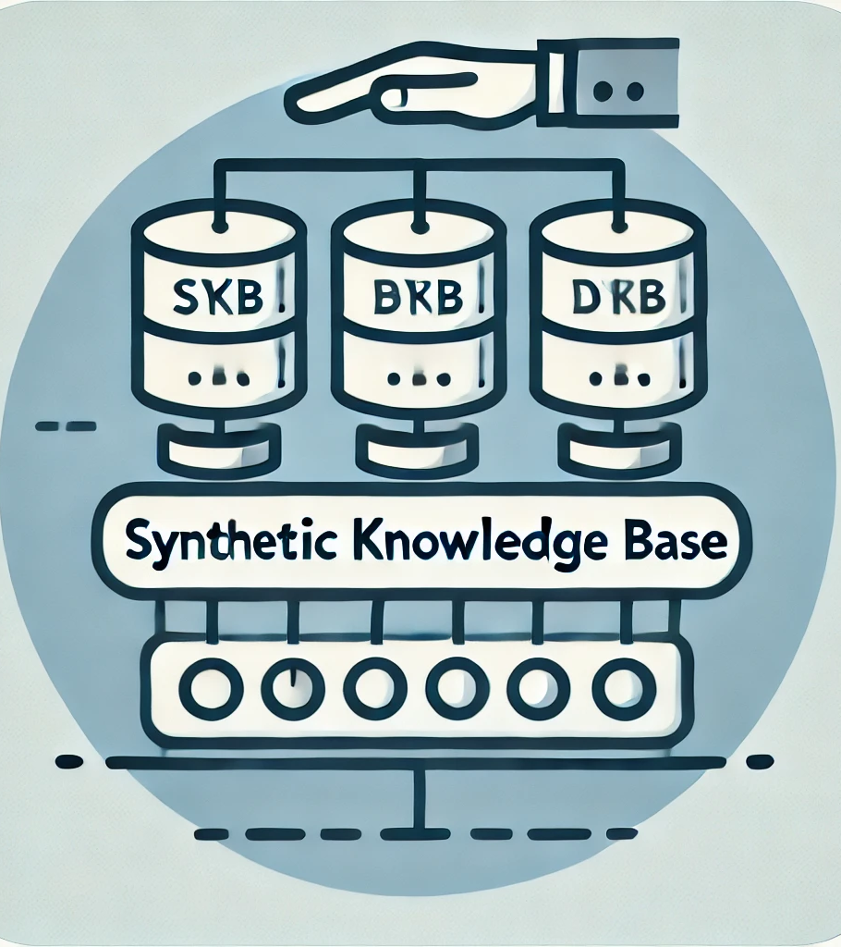
Data Source and Approach
Crucially, we're not using real student data. Privacy is our top priority.
Instead, we're building a synthetic knowledge base for development and demonstration.
This includes representative ISSS policy documents, FAQs, and mock student profiles with requests.
This allows us to test the chatbot's functionality without compromising any student information.

Slide 4
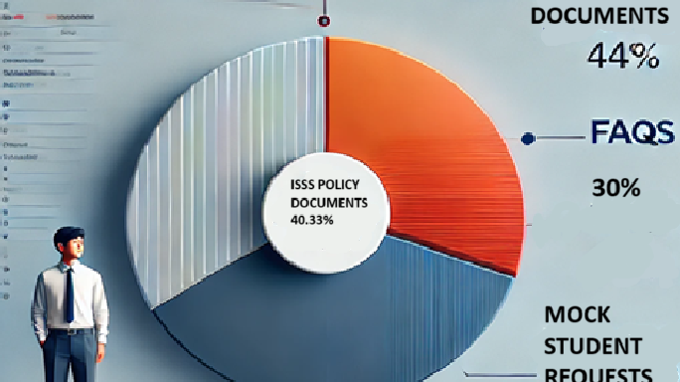
What’s Inside the Knowledge Base?
The knowledge base will contain:
Representative ISSS policy documents based on publicly available information.
A comprehensive set of FAQs covering common student inquiries.
Mock student data and associated requests (e.g., I-20 requests, visa questions).
This data is completely artificial and mimics real-world scenarios.

Slide 5
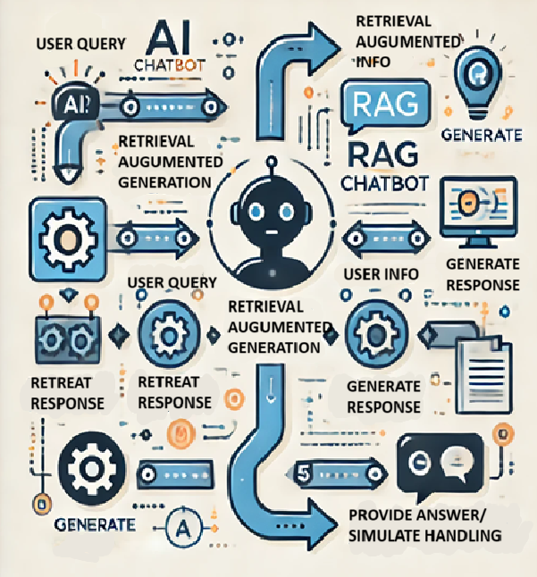
How the Chatbot Works
The chatbot uses Retrieval Augmented Generation (RAG) with an LLM.
When a student asks a question, the chatbot retrieves relevant information from the synthetic knowledge base.
It then uses the LLM to generate a clear and informative response, citing relevant documents or FAQs.
For requests, the chatbot simulates processing using the mock student data.
For example, it can simulate submitting an I-20 request and updating the (mock) status.
No actual requests are submitted to UMBC systems.

Slide 6
Why This Matters & Next Steps
Again, no real student data is used. Privacy is paramount
The focus is on demonstrating the chatbot's ability to understand, retrieve, generate responses, and simulate request processing.
This is a proof-of-concept. Future integration with real UMBC systems would require further development, approvals, and anonymized/aggregated data.
This project offers a valuable demonstration of AI's potential in student support while adhering to ethical practices.

Slide 7

The Future of AI in Student Services
We believe this approach provides a strong foundation for a future, privacy-preserving ISSS chatbot.

